Slide 1
Chapter 3 MOS Design Logic Styles (Ref- ch-7, 8-Kang) EXTC – TE – DVLSI Swati Rane Assistant Professor Dept. of Electronics and Telecommunication SIES Graduate School of Technology
DVLSI

Slide 2
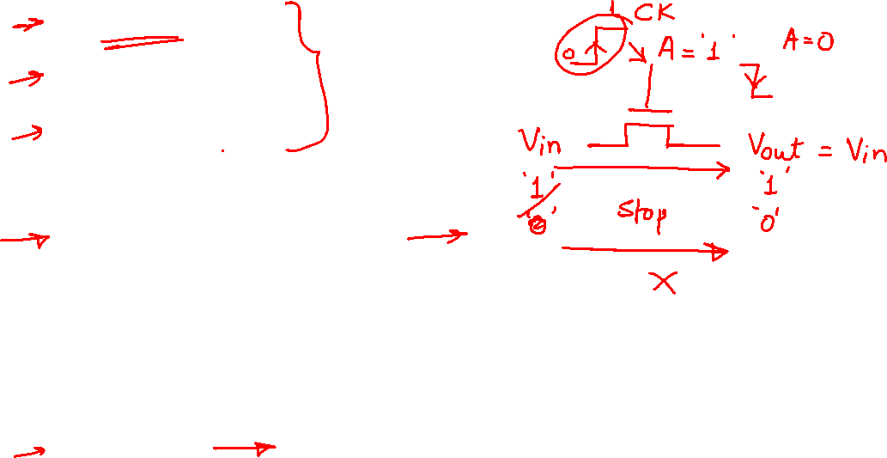
MOS Design Logic Styles
Static CMOS
Pseudo NMOS
Dynamic Logic
Domino Logic
Pass Transistor Logic
Transmission Gate
NORA
Zipper
C2MOS

Slide 3
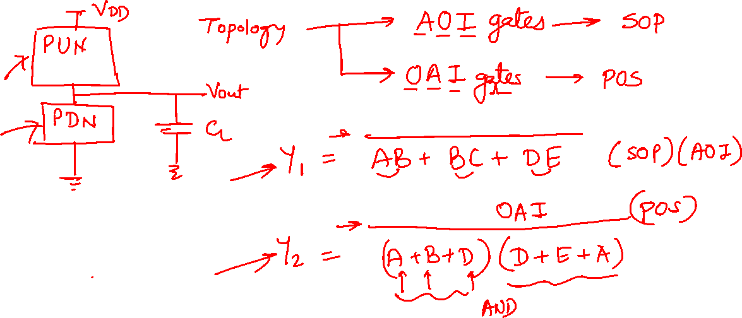

Slide 4
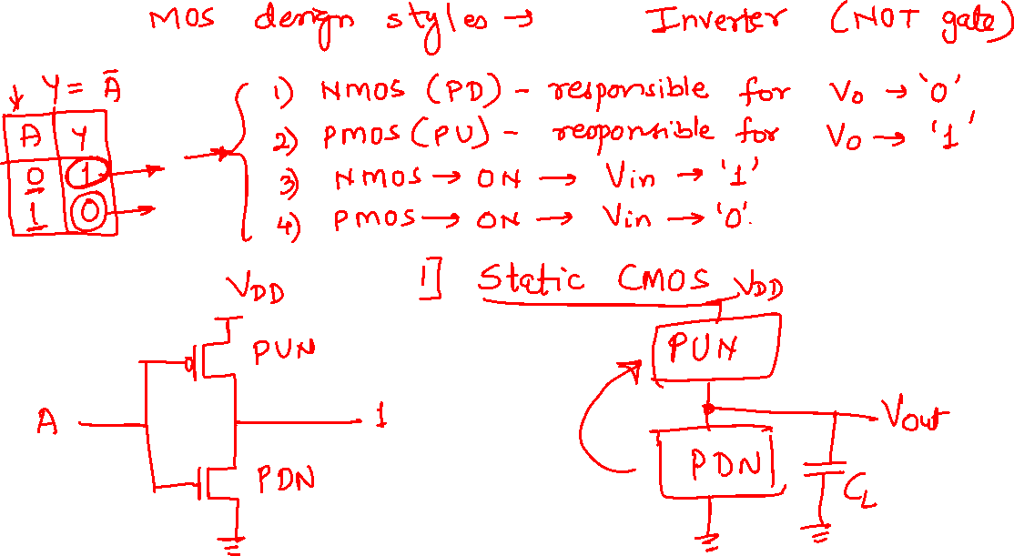
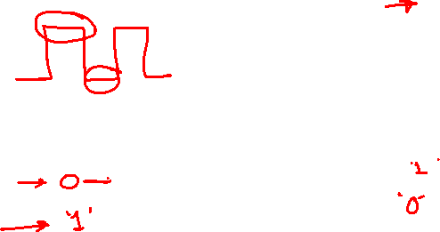
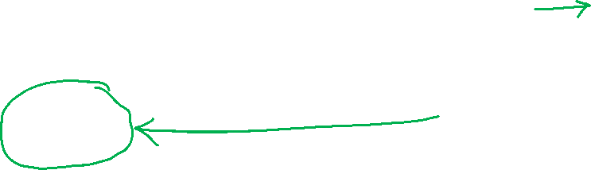

Slide 5
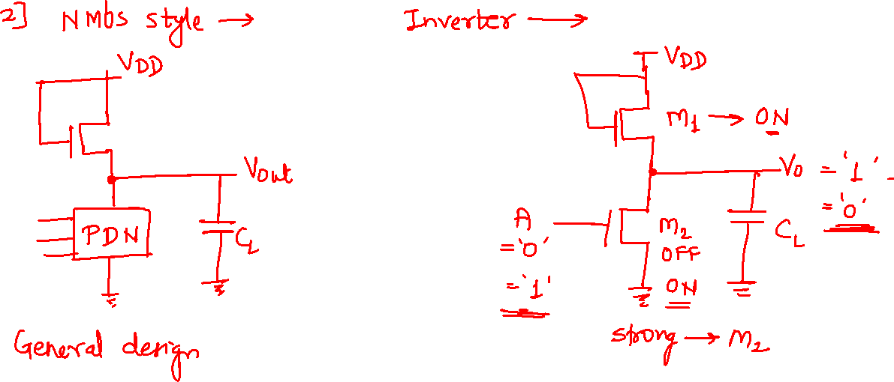


Slide 6
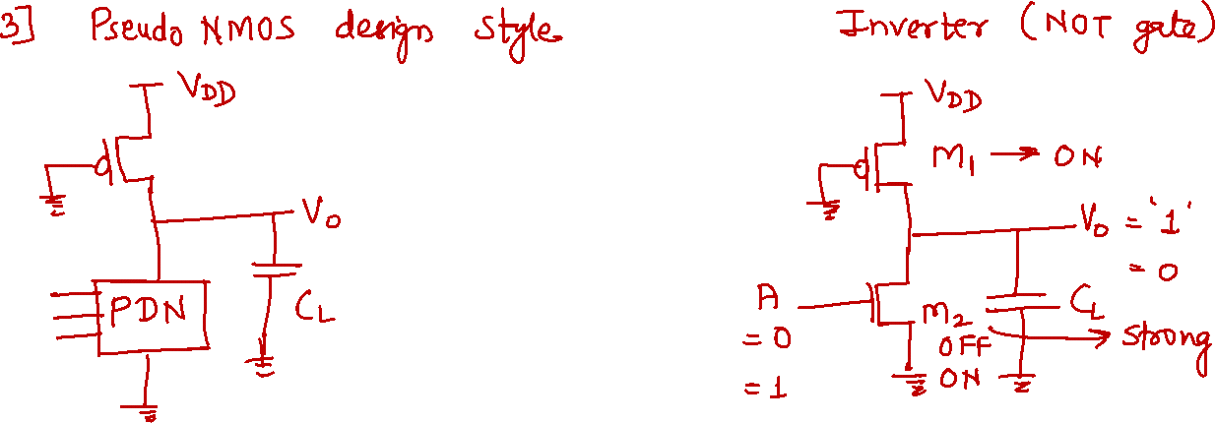

Slide 7
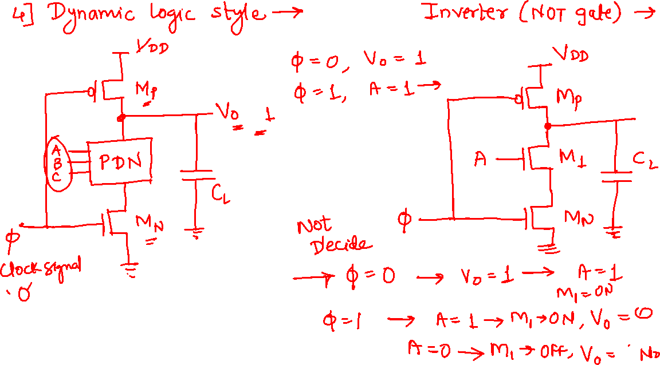
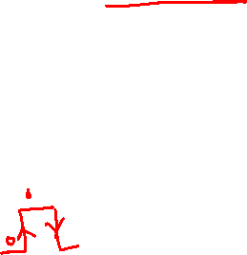

Slide 8
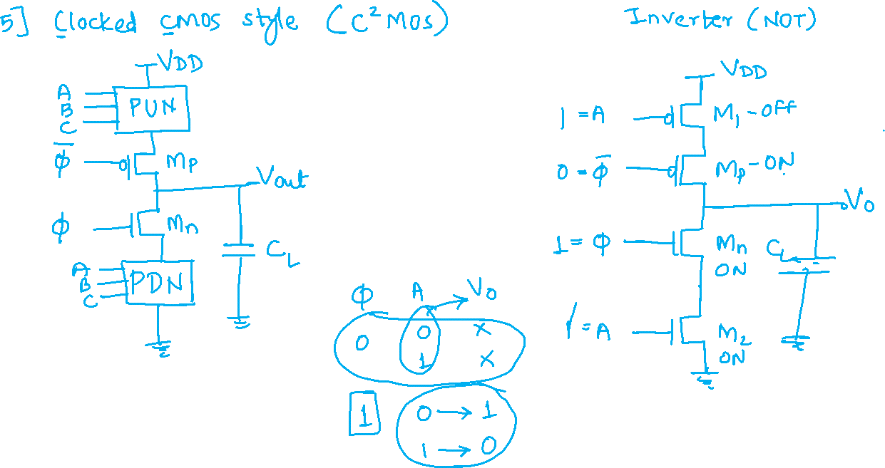

Slide 9
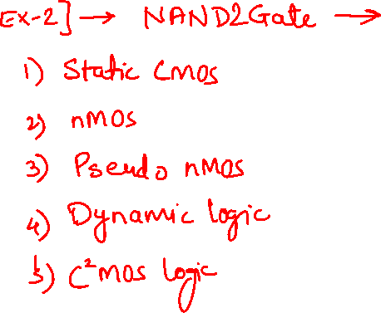
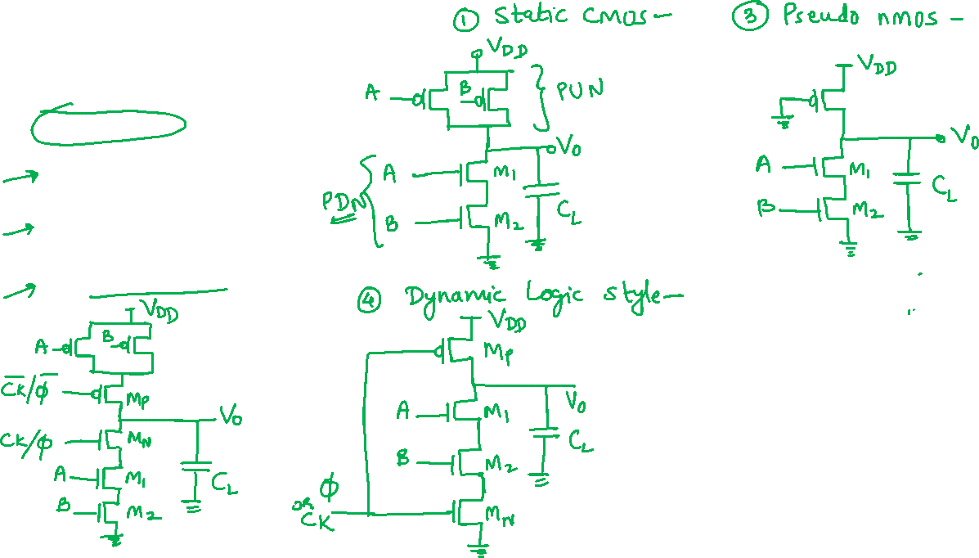

Slide 10
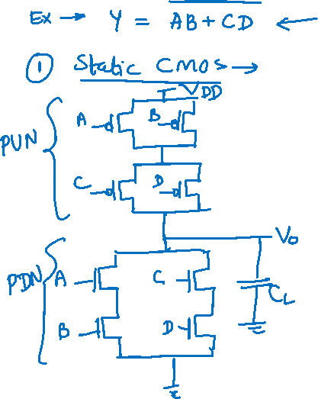

Slide 11
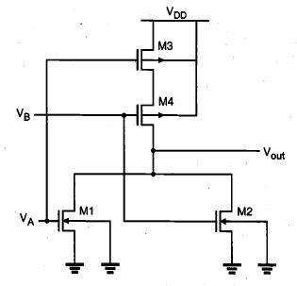

Slide 14
Static logic circuits
Static logic circuits allow versatile implementation of logic functions based on static, or steady-state, behavior of simple nMOS or CMOS structures.
Hence, a typical static logic gate generates its output corresponding to the applied input voltages after a certain time delay, and it can preserve its output level (or state) as long as the power supply is provided.
This approach, however, may require a large number of transistors to implement a function, and may cause a considerable time delay.

Slide 15

Dynamic Logic Circuits
In high-density, high-performance digital implementations where reduction of circuit delay and silicon area is a major objective, dynamic logic circuits offer several significant advantages over static logic circuits.
The operation of all dynamic logic gates depends on temporary (transient) storage of charge in parasitic node capacitances, instead of relying on steady-state circuit behavior.
This operational property necessitates periodic updating of internal node voltage levels, since stored charge in a capacitor cannot be retained indefinitely.
Consequently, dynamic logic circuits require periodic clock signals in order to control charge refreshing.
The use of common clock signals throughout the system enables us to synchronize the operations of various circuit blocks. As a result, dynamic circuit techniques lend themselves well to synchronous logic design.
The dynamic logic implementation of complex functions generally requires a smaller silicon area than does the static logic implementation.
The dynamic circuit implementation in a smaller area will, in many cases, consume less power than the static counterpart, despite its use of clock signals.

Slide 16
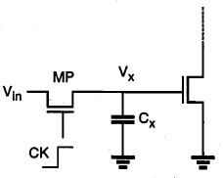
Pass Transistor Circuits
Ref- Kang-9.2
The fundamental building block of nMOS dynamic logic circuits, consisting of an nMOS pass transistor driving the gate of another nMOS transistor.
The pass transistor MP is driven by the periodic clock signal and acts as an access switch to either charge up or charge down the parasitic capacitance Cx, depending on the input signal Vin.
When the clock signal is active (CK = 1), two possible operations are
the logic " 1 " transfer (charging up the capacitance Cx to a logic-high level) and
the logic "0" transfer (charging down the capacitance Cx to a logic-low level).
When the clock signal becomes inactive (CK = 0), the pass transistor ceases to conduct and the charge stored in the parasitic capacitor Cx continues to determine the output level of the inverter.

Slide 17
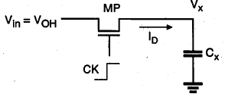


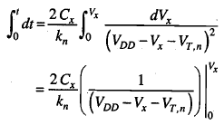
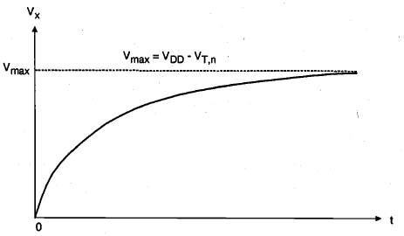

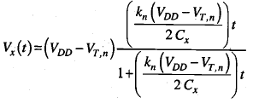
Pass Transistor Circuits
Ref- Kang-9.2
Logic "1" Transfer:

Slide 19

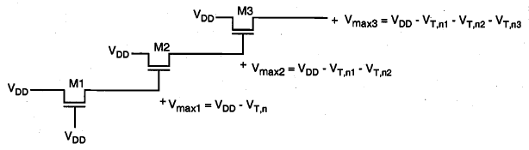
Pass Transistor Circuits
Node voltages in a pass-transistor chain during the logic " 1 " transfer.
Node voltages during the logic " 1 " transfer, when each pass transistor is driving another pass transistor.

Slide 20
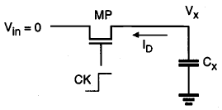
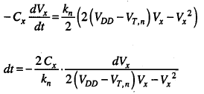
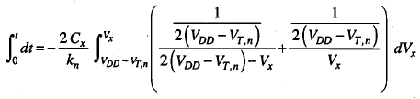
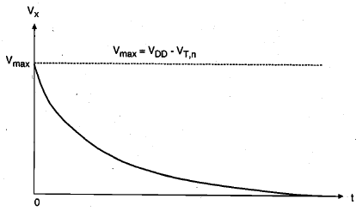


Pass Transistor Circuits
Logic “0" Transfer:

Slide 21
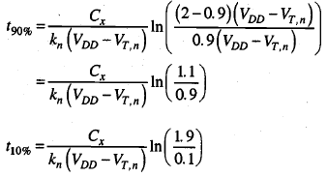
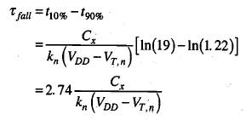

Slide 23
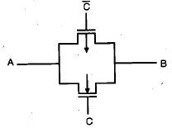
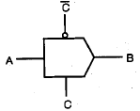
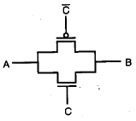
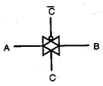
CMOS Transmission Gates (Pass Gates)
If the control signal C is logic-high, i.e., equal to VDD, then both transistors are turned on and provide a low-resistance current path between the nodes A and B.
If, on the other hand, the control signal C is low, then both transistors will be off, and the path between the nodes A and B will be an open circuit. This condition is also called the high-impedance state.
Note that the substrate terminal of the nMOS transistor is connected to ground and the substrate terminal of the pMOS transistor is connected to VDD.

Slide 24
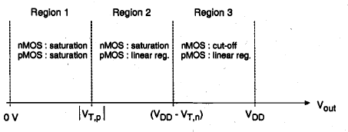
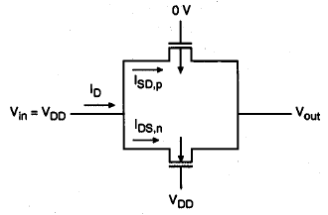

Slide 26
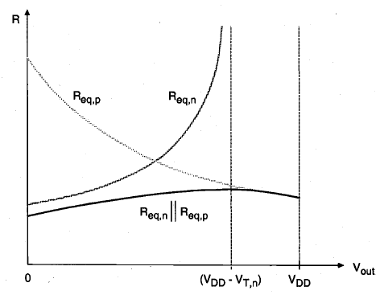

Slide 27
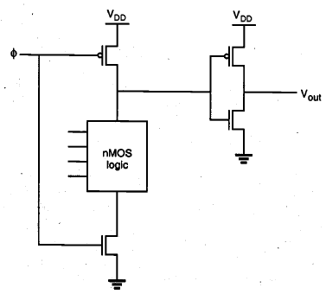
Domino CMOS Logic
A dynamic CMOS logic stage is cascaded with a static CMOS inverter stage.
The addition of the inverter allows us to operate a number of such structures in cascade.
Domino CMOS logic gates allow a significant reduction in the number of transistors required to realize any complex Boolean function.

Slide 28
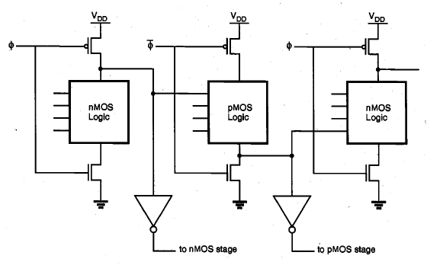
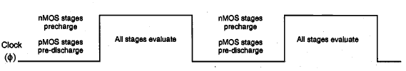
NORA CMOS Logic (NP-Domino Logic)
In domino CMOS logic gates, all logic operations are performed by the nMOS transistors acting as pull-down networks, while the role of pMOS transistors is limited to precharging the dynamic nodes.
As an alternative and a complement to nMOS-based domino CMOS logic, we can construct dynamic logic stages using pMOS transistors as well.

Slide 29

NORA CMOS Logic (NP-Domino Logic)
The advantage of NORA CMOS logic is that a static CMOS inverter is not required at the output of every dynamic logic stage.
The second important advantage of NORA CMOS logic is that it allows pipelined system architecture.
As in all dynamic CMOS structures, NORA CMOS logic gates also suffer from charge sharing and leakage.
To overcome the dynamic charge sharing and soft- node leakage problems in NORA CMOS structures, a circuit technique called Zipper CMOS can be used.

Slide 30
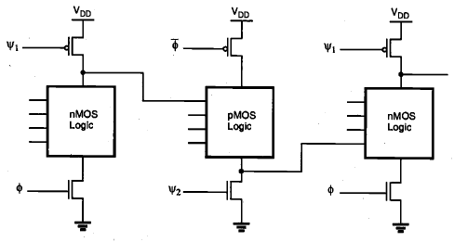
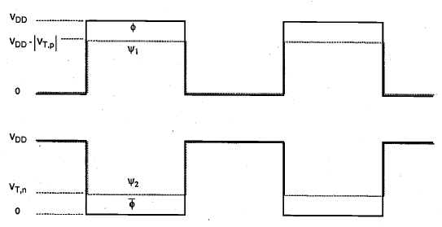
Zipper CMOS Circuits
The Zipper CMOS clock scheme requires the generation of slightly different clock signals for the precharge (discharge) transistors and for the pull-up (pull-down) transistors.
The clock signals which drive the pMOS precharge and nMOS discharge transistors allow these transistors to remain in weak conduction or near cut-off during the evaluation phase, thus compensating for the charge leakage and charge-sharing problems.

Slide 31
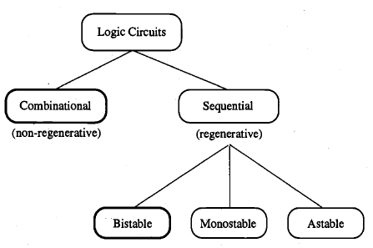
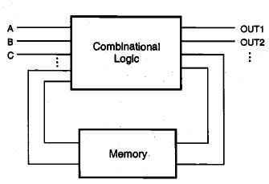
SEQUENTIAL MOS LOGIC CIRCUITS
The output is determined by the current inputs as well as the previously applied input variables.
Regenerative operation can, under certain conditions, also be interpreted as a simple memory function.
The bistable circuits are by far the most widely used. All basic latch and flip-flop circuits, registers, and memory elements used in digital systems fall into Bistable category.

Slide 32
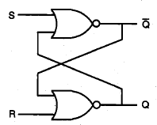
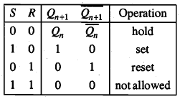
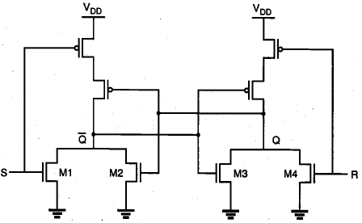
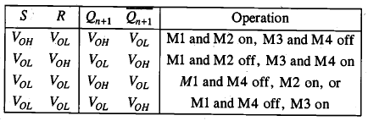
The SR Latch Circuit

Slide 33
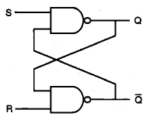
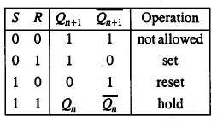
The SR Latch Circuit

Slide 34
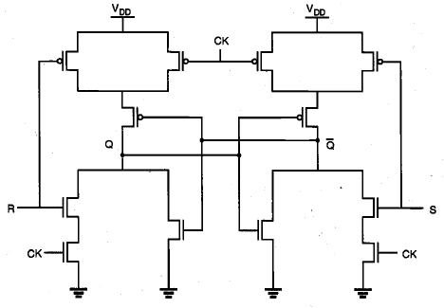
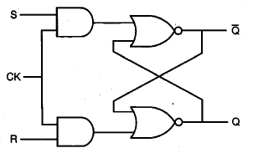
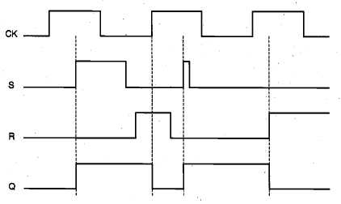
Clocked SR Latch
Asynchronous sequential circuits responds to the changes occurring in input signals at a circuit-delay-dependent time point during their operation.
To facilitate synchronous operation, the circuit response can be controlled simply by adding a gating clock signal to the circuit, so that the outputs will respond to the input levels only during the active period of a clock pulse.
If the clock (CK) is equal to logic "0," the input signals have no influence upon the circuit response.
When the clock input goes to logic " 1," the logic levels applied to the S and R inputs are permitted to reach the SR latch, and possibly change its state.

Slide 35
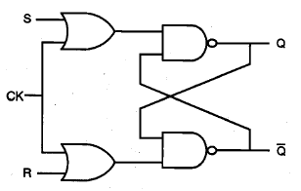


Clocked SR Latch
The NAND-based SR latch can also be implemented with gating clock input.
It must be noted, however, that both input signals S and R as well as the clock signal CK are active low in this case.
A different implementation of the clocked NAND-based SR latch.
Here, both input signals and the CK signal are active high.
The latch output Q will be set when CK = " 1," S = " 1," and R = “0."
The latch will be reset when CK = "1," S = “0," and R = "1."
The latch preserves its state as long as the clock signal is inactive, i.e., when CK = “0".
The drawback of this implementation is that the transistor count is higher than the active low version

Slide 36



Clocked JK Latch
The simple and clocked SR latch circuits suffer from the common problem of having a not-allowed input combination, i.e., their state becomes indeterminate when both inputs S and R are activated at the same time.
This problem can be overcome by adding two feedback lines from the outputs to the inputs, resulting into a JK latch.

Slide 37


Clocked JK Latch
NOR-based implementation of the clocked JK latch, and CMOS realization of this circuit.
Note that the AOI-based circuit structure results in a relatively low transistor count, and consequently, a more compact circuit compared to the all-NAND realization.

Slide 38

Master-Slave JK Flip-Flop
When the clock pulse is high →
The input latch (master latch) is activated.
The inputs J and K allow data to be entered into the flip-flop, and the first-stage outputs are set according to the primary inputs.
When the clock pulse goes to zero →
The master latch becomes inactive t
The second-stage latch (slave latch) becomes active.
The output levels of the flip-flop circuit are determined based on the master-stage outputs set in the previous phase.
Since the master and the slave stages are effectively decoupled from each other with the opposite clocking scheme, a change occurring in the primary inputs is never reflected directly to the outputs.

Slide 39
Master-Slave JK Flip-Flop

Slide 40

Master-Slave JK Flip-Flop
NOR-based realization of the JK master-slave flip-flop.

Slide 41

CMOS D-Latch
Direct CMOS implementations of conventional circuits such as the clocked JK latch or the JK master-slave flip-flop tend to require a large number of transistors.
In this section, we will see that specific versions of sequential circuits built primarily with CMOS transmission gates are generally simpler and require fewer transistors than the circuits designed with conventional structuring.
When the clock is active (CK = 1)
The output Q assumes the value of the input D
When the clock signal goes to zero (CK=0):
The output will simply preserve its state.
Thus, the CK input acts as an enable signal which allows data to be accepted into the D-latch.

Slide 42



The D-latch finds many applications
in digital circuit design, primarily for temporary storage of data or as a delay element.

Slide 44


Slide 45

CMOS negative edge-triggered master-slave D flip-flop

Slide 46

CMOS negative edge-triggered master-slave D flip-flop

Slide 47
CMOS negative edge-triggered master-slave D flip-flop
The first stage (master) is driven by the clock signal, while the second stage (slave) is driven by the inverted clock signal.
Thus, the master stage is positive level-sensitive, while the slave stage is negative level-sensitive.
When the clock is high:
the master stage follows the D input while the slave stage holds the previous value.
When the clock changes from logic "1" to logic “0“:
the master latch ceases to sample the input and stores the D value at the time of the clock transition.
At the same time, the slave latch becomes transparent, passing the stored master value Qm to the output of the slave stage, Qs.
The input cannot affect the output because the master stage is disconnected from the D input.
When the clock changes again from logic “0" to “1“:
the slave latch locks in the master latch output and the master stage starts sampling the input again.
Thus, this circuit is a negative edge-triggered D flip-flop by virtue of the fact that it samples the input at the falling edge of the clock pulse.

Slide 48
1 Bit Full adder

Slide 49
1 Bit Full adder

Slide 50

1 Bit Full adder
This implementation will ultimately reduce the circuit complexity and, hence, save chip area.

Slide 51

1 Bit Full adder

Slide 52
1 Bit Full adder
The circuit contains a total of 14 nMOS and 14 pMOS transistors, together with the two CMOS inverters which are used to generate the outputs.
All nMOS and pMOS transistors in this layout have the same (W/L) ratio.

Slide 53

Ripple Carry Adder
The full-adder circuit is the basic building block of a general n-bit binary adder
It accepts two n-bit binary numbers as input and produces the binary sum at the output.
The overall speed of the carry ripple adder is obviously limited by the delay of the carry bits rippling through the carry chain; therefore, a fast carry-out response becomes essential for the overall performance of the adder chain.

